Slide 1

HOUSE PRICE PREDICTION WASHINGTON DC
GROUP 3
Asfia Hani
Mahe Jabeen
Hijam Gyaneswar Singh
Hitesh
Arvind Goli
Mentored By: Animesh Tiwari

Slide 2
Agenda
Problem Statement
About the dataset
Data Challenges & Data Preparation
EDA
Outlier Treatment
Baseline Model
Ensemble Techniques
Feature Selection
Business Recommendations

Slide 3
Problem Statement
To build a prediction model to evaluate the price of a house with the given features.
Business Importance:
Traditional house price prediction is based on cost and sale price comparison, lacking of an accepted standard and a certification process. Therefore, the availability of a house price prediction model helps fill up an important information gap and improve the efficiency of the real estate market

Slide 4
About the dataset
This dataset contains house sale prices for the state of Washington, United States. It includes houses sold between May 2014 and May 2015.
There are 21613 records/rows with 23 columns/features of the houses.
The dataset is great for evaluating simple regression models.

Slide 5
Features
Dependent variable
Dependent variable
Dependent variable
Independent variable
Price
Continuous
Categorical
dayhour
living_measure
lot_measure
ceil_measure
basement_measure
yr_built
yr_renovated
lat
long
living_measure_15
lot_measure_15
total_area
room_bed
room_bath
ceil
coast
sight
condition
quality
zipcode
furnished

Slide 6
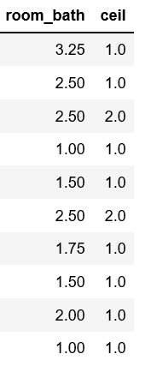
Data Interpretation
There were features like ‘room_bath’ and ‘ceil’ in our data where the values were unusual, as shown below
So, the bath_room column is interpreted as
0.25 bath- toilet, no sink, no shower, no tub.
0.5 bath- sink, toilet, no shower, no tub
0.75 bath- sink, toilet, shower, no tub Full bath- everything,
E.g. 1.25 means one bathroom having only toilet
Similarly with the feature ceil, where .5 means it is a partially built floor, i.e. a pent house in the top.

Slide 7
Data Challenges & Preparation
Data Challenges
Data Preparation
Data Cleaning :
Incorrect datatypes and formats.
Outliers :
5.87% of data has atleast one outlier in each row. The rows cannot be removed as the percentage is significant enough to cause data loss.
Multicollinearity :
Presence of collinearity between different independent features.
Area measures are correlated.
Data Transformation:
Updating the column dayhour to appropriate format
Changing the Datatype of Categorical columns to object.
Creating a age column of the house column
Creating new columns, region and city.
Outlier Treatment:
Replacing the outliers with null.
Imputing the null value using MICE (Multivariate imputation by chained equations).
Feature Elimination:
Feature elimination using RFE (Recursive Feature Elimination)

Slide 8
Exploratory Data Analysis
Our EDA objective will be to understand how the variables in this dataset relate to the sale price of a house

Slide 9
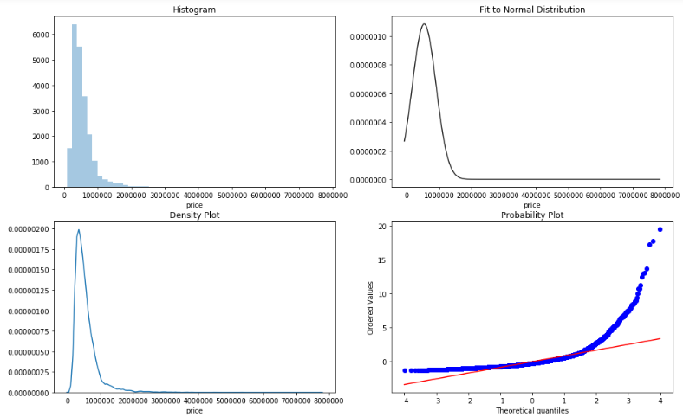
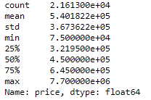
Checking the Skewness of Target Variable
Min Price: $75,000
Median Price:$450,000,
Max Price: $7,700,000
Notes:
The above histogram plot indicates that the distribution of the Price exhibits
a positive skewness (right skewed) and that the peakedness deviates from normal distribution.
The skewness can be visualized by a probability plot of the Price against the quantiles
of the normal distribution.

Slide 10
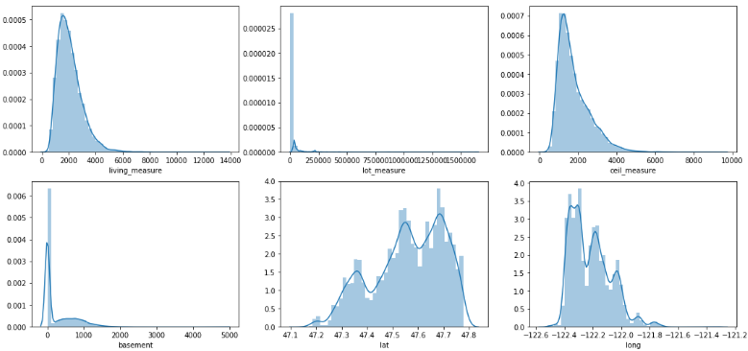
Univariate Analysis for Continuous Variables
lot_measure,lot_measure15 like with continuous values do not exhibit normal distributions.
We will try to improve the skewness of these features in order to fit the dataset.

Slide 11
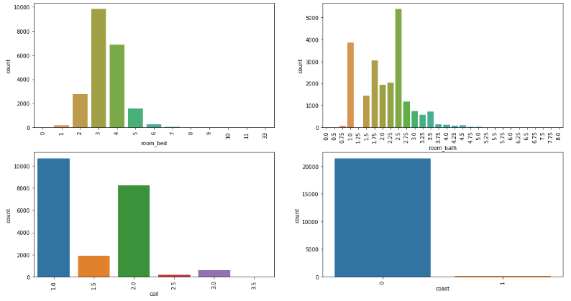
Univariate Analysis for Categorical
Categorical Description
room_bed:
Minimum Bed : 0
Median Bed : 3
Maximum Bed : 33

Slide 12
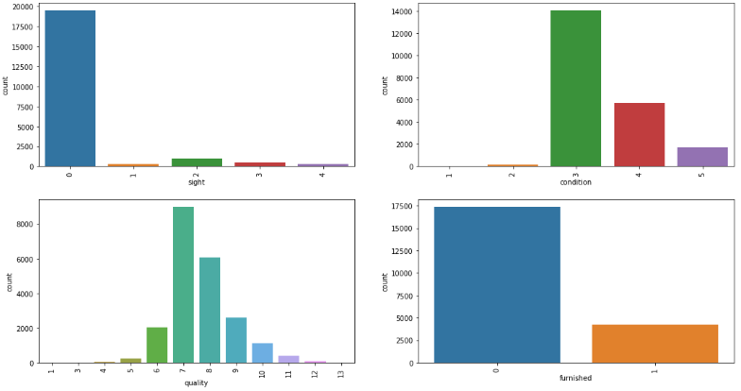
Univariate Analysis for Categorical

Slide 13
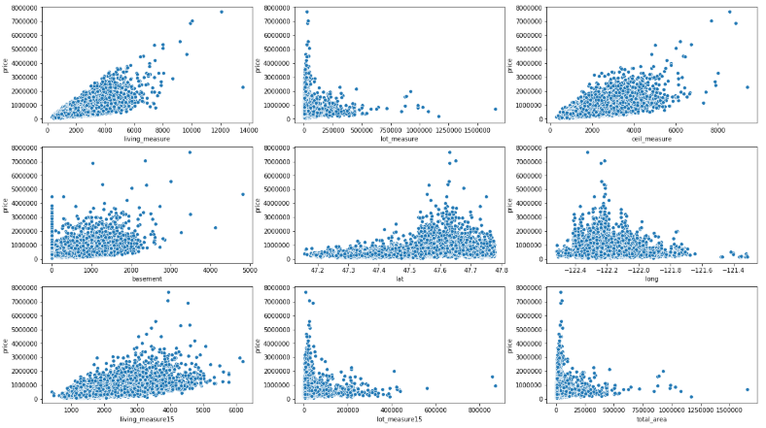
Bivariate Analysis For Continuos
Price Vs Continuous
highly Correlated:
living_measure,
living_measure_15,
weakly Correlated:
ceil_measure,
Basement_measure,
Not Correlated:
lot_measure
lot_measure15

Slide 14
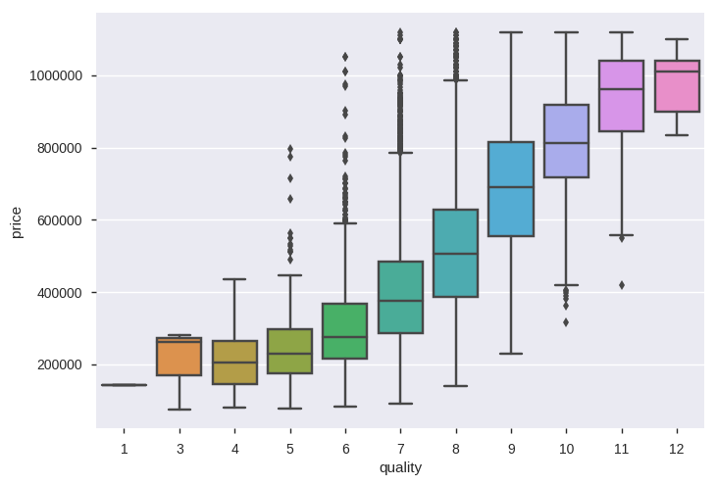
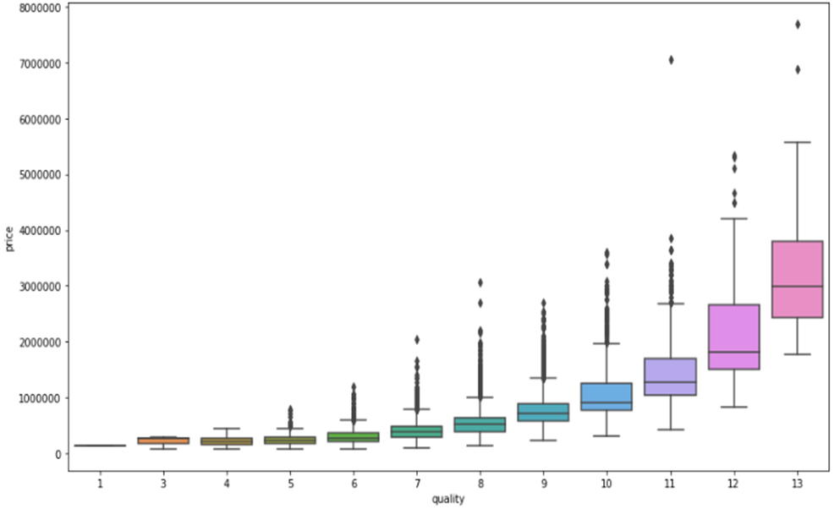
Bivariate Analysis For Categorical
Price Vs Categorical
quality
coast
room_bath
furnished
Weakly Correlated:
room_bed
sight
condition
ceil

Slide 15
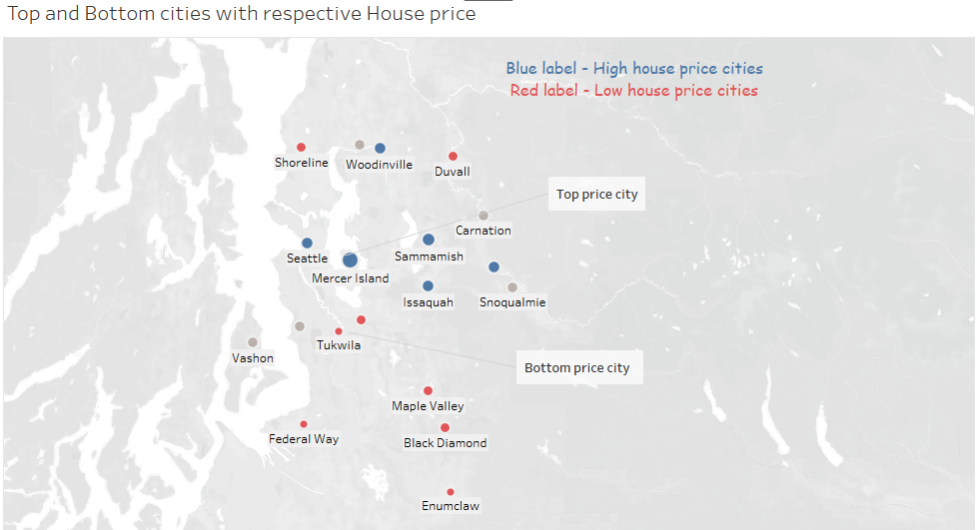
Top and Bottom cities with respective House price

Slide 16
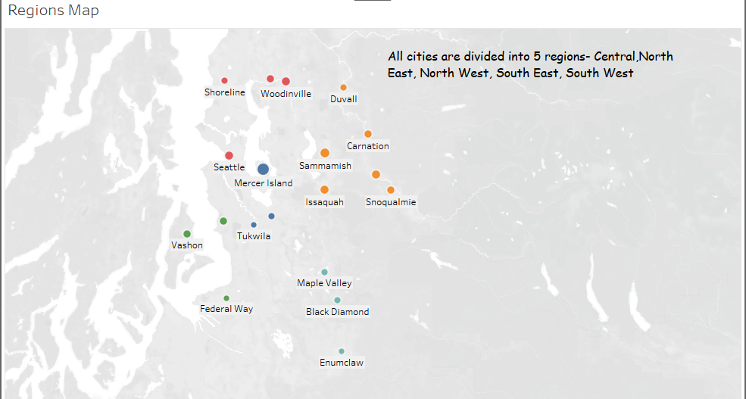
Regions Wise Map

Slide 17
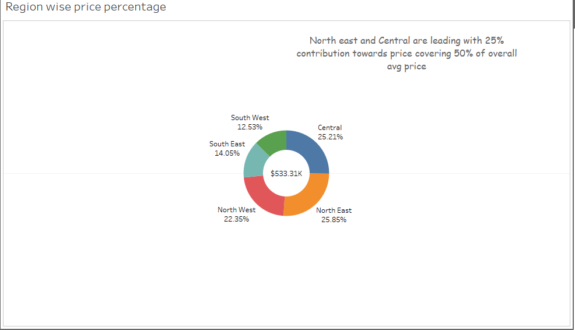
Region wise price percentage

Slide 18
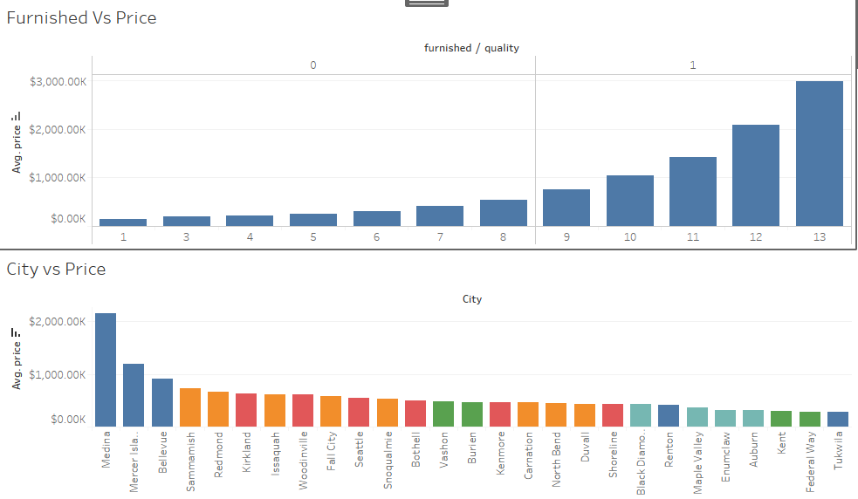

Slide 19
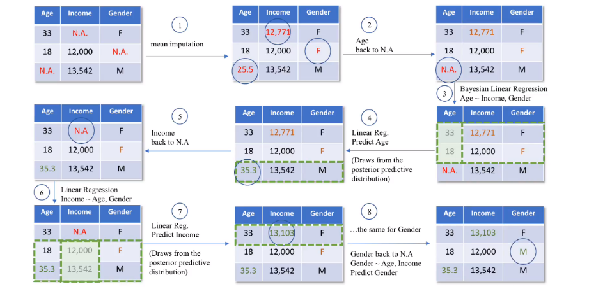
Outlier Treatment
Multivariate Imputation using Chained Equations(MICE) – single iteration

Slide 20
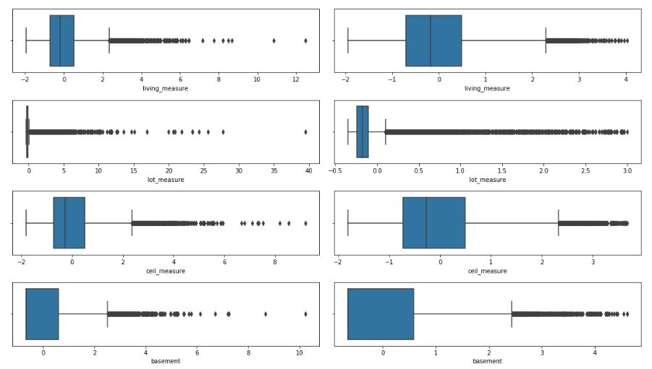
Comparison

Slide 21
Baseline Model
Linear Regression Algorithm
Adjusted R-square : 0.709
Homoscedasticity:
Autocorrelation:
Goldfeld Quandt Test:
Null Hypothesis: Error terms are homoscedastic
Alternative Hypothesis: Error terms are heteroscedastic.
p_val = 0.0386
Ljungbox test:
Null Hypothesis: Autocorrelation is absent.
Alternative Hypothesis: Autocorrelation is present.
p_val = 0.18

Slide 22
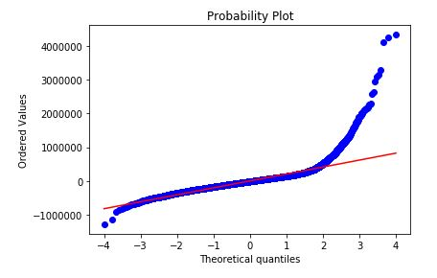
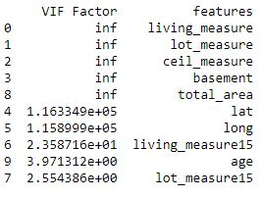
Baseline Model
Linear Regression Algorithm
Adjusted R-square : 0.709
Multicollinearity:
Normal Distribution:

Slide 23
Ensemble Techniques

Slide 24
After RFE

Slide 25
Business Recommendations
Living Measure: Most of the regression explained by this variable
Coast: Whether house is near to coast or not
Quality: Higher the quality and Higher price
Furnished: Furnished house having higher price

